Slide 1



Text Summarization
Project ID: 21214
Student 1: Abhishek Sahu
Roll No: CSE201712331
BPUT Regn. No: 1701202228
Student 2: Biswajit Padhi
Roll No: CSE201710293
BPUT Regn. No: 1701202408
Under the guidance of
Dr. Rakesh Patra
Notes:
B-TECH PROJECT MID-SEM PRESENTATION 2011
BY KHUSHBU KHAN & ISAN SAHOO

Slide 2
Table of contents:
Description
Workflow
Data Collection
Pre-processing
Work Embedding
Similarity Matrix
Sentence Ranking
Abstract Generation
References
Notes:
B-TECH PROJECT MID-SEM PRESENTATION 2011
BY KHUSHBU KHAN & ISAN SAHOO
2

Slide 3
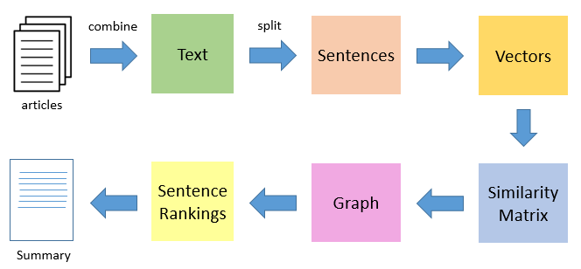
Description
It’s the process of summarizing a large text document into a smaller summarized text.
The summarized text contains the most relevant information or context provided by the original document.
We will create a system to generate an extractive summary.
Workflow:

Slide 4
STEP 1: DATA COLLECTION
Get the content of the Article
WEB Scrapping
Combine Multiple Article *
We have taken some news articles from “THE HINDUS”

Slide 5
STEP 2: PREPROCESSING
Sentence Tokenization
[ “Baniyan Tree gives 24X7 oxygen. It have medicinal properties. It have hanging roots.” ]
[ “Baniyan Tree gives 24X7 oxygen.”,
“It have medicinal properties.”,
“It have hanging roots.” ]

Slide 6
Cleaning ( Special Symbol, Numbers, Stop word removal, Lower Case )
[ “Baniyan Tree gives 24X7 oxygen.”,
“It have medicinal properties.”
“It have hanging roots.”]
[ “baniyan tree gives x oxygen”,
“ have medicinal properties”,
“ have hanging roots”]

Slide 7
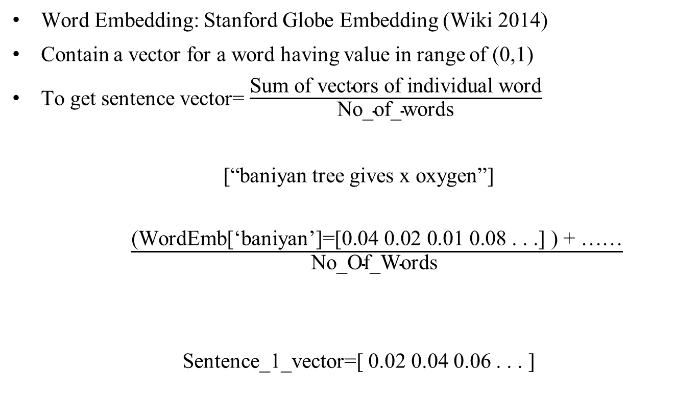
STEP 3: CONVERTING TO VECTORS
Word Embedding: Stanford Globe Embedding (Wiki 2014)
Contain a vector for a word having value in range of (0,1)
To get sentence vector= $\frac{\text{Sum} \text{of} \text{vectors} \text{of} \text{individual} \text{word}}{\text{No}\text{_}\text{of}\text{_}\text{words}}$
[“baniyan tree gives x oxygen”]
$\frac{\text{(}\text{WordEmb}\text{[‘}\text{baniyan}\text{’]=[0.04 0.02 0.01 0.08 . . .] ) + ……}}{\text{No}\text{_}\text{Of}\text{_}\text{Words} }$
Sentence_1_vector=[ 0.02 0.04 0.06 . . . ]

Slide 8
STEP 5: SIMILARITY MATRIX
Create a matrix of dimension No_of_Sentence X No_of_Sentence
We are using Cosine Similarity*
Cosine_Similarity(Sentence_1,Sentence_2) : give a similarity value between sentence 1 and sentence 2
Sentences | 1 | 2 | 3
1 | 0 | 1.1 | 2.1
2 | 1.1 | 0 | 0.8
3 | 2.1 | 0.8 | 0

Slide 9
STEP 6: GRAPH GENERATION
Using above Similarity matrix, we are going to create a weighted undirected graph
2.1 1.1
0.8
1
3
2

Slide 10
STEP 7: SENTENCE RANKING
Google Page Rank Algorithm
Graph -> Ranking Points
SENTENCE | POINTS
1 | 0.034
2 | 1.086
3 | 0.739

Slide 11
STEP 8: SUMMARY GENERATION
Select a Threshold value *
Select all sentence having points > Threshold
Append
Generate the Summary

Slide 12
Reference
13] Cheng, Jianpeng, and Mirella Lapata. "Neural summarization by extracting sentences and words."arXiv preprint arXiv:1603.07252 (2016).
[2] Y. Liu, “Fine-tune BERT for extractive summarization”, CoRR, vol. abs/1903.10318, 2019. arXiv: 1903.10318. [Online]. Available: http://arxiv.org/abs/1903. 10318.
[3] M. Allahyari, S. Pouriyeh, M. Assefi, S. Safaei, E. D. Trippe, J. B. Gutierrez, and K. Kochut, “Text summarization techniques: A brief survey”, Interna-tional Journal of Advanced Computer Science and Applications, vol. 8, no. 10, 2017. doi: 10.14569/IJACSA.2017.081052.
[4] C.-Y. Lin, “ROUGE: A package for automatic evaluation of summaries”, in Text Summarization Branches Out, Barcelona, Spain: Association for Compu-tational Linguistics, Jul. 2004, pp. 74–81.
[5] K. Al-Sabahi, Z. Zuping, and M. Nadher, “A hierarchical structured self-attentive model for extractive document summarization (hssas)”, IEEE Ac-cess, vol. PP, pp. 1–1, Apr. 2018. doi: 10.1109/ACCESS.2018.2829199.
[6] A. Fabbri, I. Li, T. She, S. Li, and D. Radev, “Multi-news: A large-scale multi-document summarization dataset and abstractive hierarchical model”,
pp. 1074–1084, Jul. 2019. doi: 10.18653/v1/P19-1102.
[7] K. M. Hermann, T. Kocisky, E. Grefenstette, L. Espeholt, W. Kay, M. Suley-man, and P. Blunsom, “Teaching machines to read and comprehend”, Advances
in Neural Information Processing Systems 28, C. Cortes, N. D. Lawrence, D. D. Lee, M. Sugiyama, and R. Garnett, Eds., pp. 1693–1701, 2015.
[8] K. Papineni, S. Roukos, T. Ward, and W.-J. Zhu, “Bleu: A method for au-tomatic evaluation of machine translation”, Proceedings of the 40th annual meeting on association for computational linguistics, pp. 311–318, 2002.
Notes:
B-TECH PROJECT MID-SEM PRESENTATION 2011
BY KHUSHBU KHAN & ISAN SAHOO
12

